Slide 1
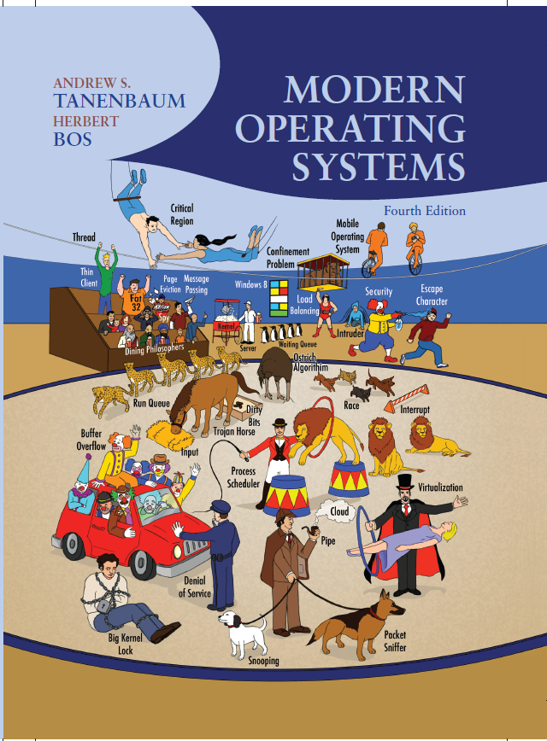
Modern Operating Systems
Fourth Edition
Chapter 10
Case Study 1: U N I X, Linux, and Android
Copyright © 2014 Pearson Education, Inc. All Rights Reserved
Notes:
If this PowerPoint presentation contains mathematical equations, you may need to check that your computer has the following installed:
1) MathType Plugin
2) Math Player (free versions available)
3) NVDA Reader (free versions available)

Slide 2
History of U N I X and Linux
U N I C S
P D P-11 U N I X
Portable U N I X
Berkeley U N I X
Standard U N I X
MINIX
Linux

Slide 3
Linux Goals
Simplicity, elegance, consistency
Power and flexibility
Lack of useless redundancy

Slide 4
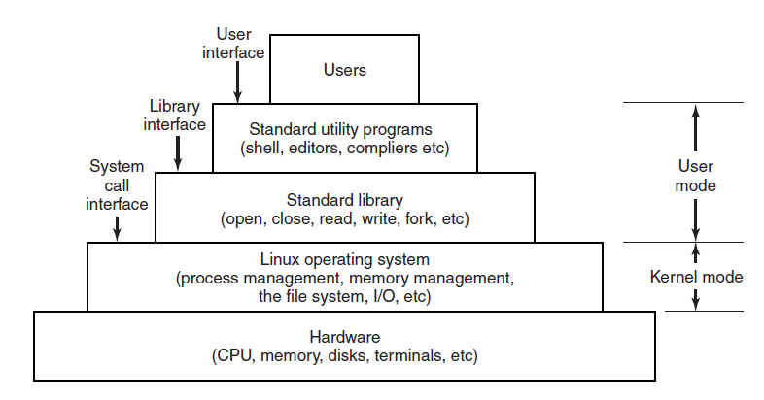
Interfaces to Linux
Figure 10-1. The layers in a Linux system.

Slide 5
The Shell
Command line interface
Faster
More powerful
Easily extensible
First word entered will be a program name
Commands take arguments
Wild card characters used
Filters, pipes used
Shell scripts

Slide 6
Linux Utility Programs (1 of 3)
File and directory manipulation commands.
Filters.
Program development tools, such as editors and compilers.
Text processing.
System administration.
Miscellaneous.

Slide 7
Linux Utility Programs (2 of 3)
A few of the common Linux utility programs required by P O S I X.
Program | Typical use
cat | Concatenate multiple files to standard output
chmod | Change file protection mode
cp | Copy one or more files
cut | Cut columns of text from a file
grep | Search a file for some pattern
head | Extract the first lines of a file
ls | List directory
make | Compile files to build a binary
mkdir | Make a directory

Slide 8
Linux Utility Programs (3 of 3)
A few of the common Linux utility programs required by P O S I X.
Program | Typical use
od | Octal dump a file
paste | Paste columns of text into a file
pr | Format a file for printing
ps | List running processes
rm | Remove one or more files
rmdir | Remove a directory
sort | Sort a file of lines alphabetically
tail | Extract the last lines of a file
tr | Translate between character sets

Slide 9
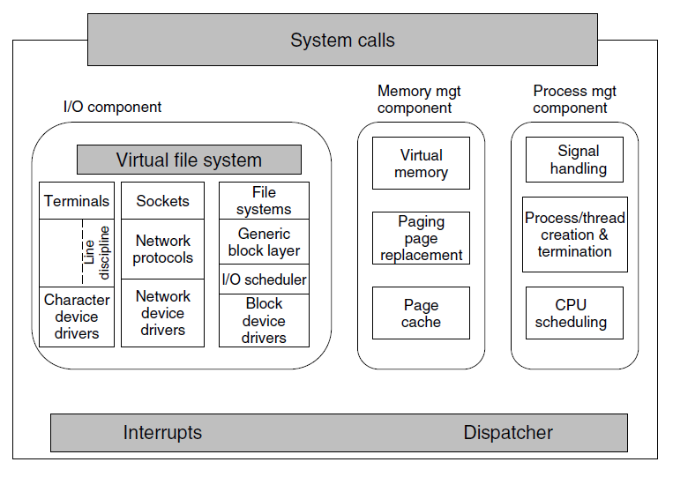
Kernel Structure
Figure 10-3. Structure of the Linux kernel

Slide 10
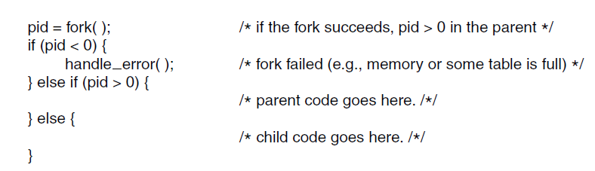
Processes: Fundamental Concepts (1 of 2)
Figure 10-4. Process creation in Linux.

Slide 11
Processes: Fundamental Concepts (2 of 2)
Some of the signals required by P O S I X.
Signal | Cause
S I G A B R T | Sent to abort a process and force a core dump
S I G A L R M | The alarm clock has gone off
S I G F P E | A floating-point error has occurred (e.g., division by 0)
S I G H U P | The phone line the process was using has been hung up
S I G I L L | The user has hit the DEL key to interrupt the process
S I G Q U I T | The user has hit the key requesting a core dump
S I G K I L L | Sent to kill a process (cannot be caught or ignored)
S I G P I P E | The process has written to a pipe which has no readers
S I G S E G V | The process has referenced an invalid memory address
S I G T E R M | Used to request that a process terminate gracefully
S I G U S R 1 | Available for application-defined purposes
S I G U S R 2 | Available for application-defined purposes

Slide 12
Process Management System Calls in Linux (1 of 2)
Some system calls relating to processes. The return code s is −1 if an error has occurred, p i d is a process I D, and residual is the remaining time in the previous alarm. The parameters are what the names suggest.
System call | Description
pid = fork( ) | Create a child process identical to the parent
pid = waitpid(pid, &statloc, opts) | Wait for a child to terminate
s = execve(name, argv, envp) | Replace a process’ core image
exit(status) | Terminate process execution and return status
s = sigaction(sig, &act, &oldact) | Define action to take on signals
s = sigretur n(&context) | Return from a signal
s = sigprocmask(how, &set, &old) | Examine or change the signal mask
s = sigpending(set) | Get the set of blocked signals
s = sigsuspend(sigmask) | Replace the signal mask and suspend the process
s = kill(pid, sig) | Send a signal to a process
residual = alarm(seconds) | Set the alarm clock
s = pause( ) | Suspend the caller until the next signal

Slide 13
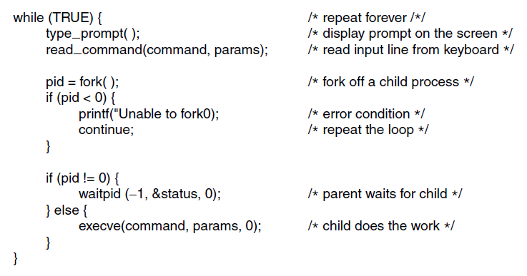
Process Management System Calls in Linux (2 of 2)
Figure 10-7. A highly simplified shell.

Slide 14
Implementation of Processes and Threads in Linux (1 of 2)
Process descriptors
Scheduling parameters
Memory image
Signals
Machine registers
System call state
File descriptor table
Accounting
Kernel stack
Miscellaneous

Slide 15
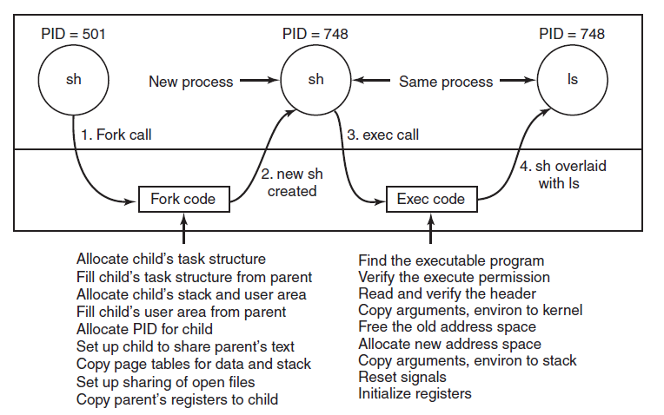
Implementation of Processes and Threads in Linux (2 of 2)
Figure 10-8. The steps in executing the command l s typed to the shell.

Slide 16
Threads in Linux
Bits in the sharing flags bitmap.
Flag | Meaning when set | Meaning when cleared
CLONE_V M | Create a new thread | Create a new process
CLONE_F S | Share umask, root, and working dirs | Do not share them
CLONE_FILES | Share the file descriptors | Copy the file descriptors
CLONE_SIGHAND | Share the signal handler table | Copy the table
CLONE_PARENT | New thread has same parent as the caller | New thread’s parent is caller

Slide 17
Scheduling in Linux (1 of 3)
Three classes of threads for scheduling purposes:
Real-time F I F O.
Real-time round robin.
Timesharing.

Slide 18
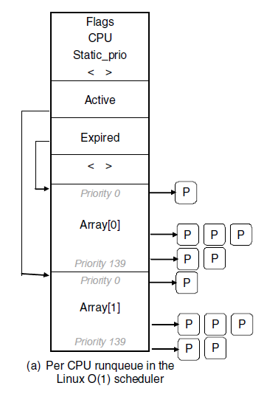
Scheduling in Linux (2 of 3)
Figure 10-10. Illustration of Linux run queue data structures for (a) the Linux O(1) scheduler

Slide 19
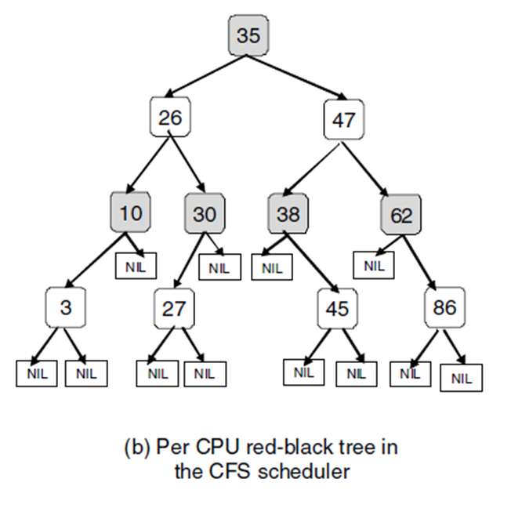
Scheduling in Linux (3 of 3)
Figure 10-10. Illustration of Linux run queue data structures for (b) the Completely Fair Scheduler

Slide 20
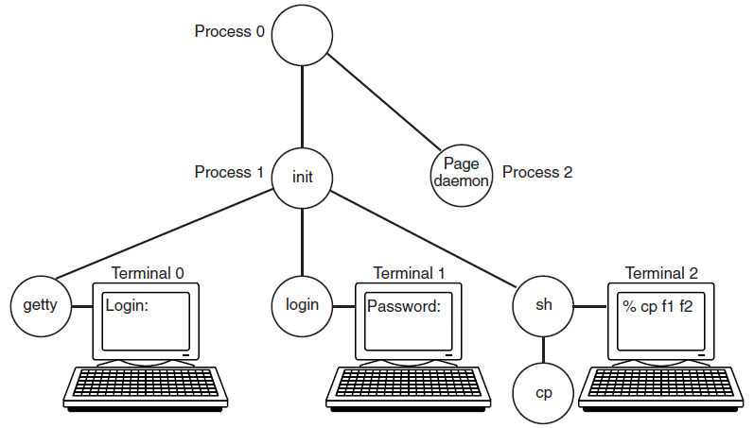
Booting Linux
Figure 10-11. The sequence of processes used to boot some Linux systems.

Slide 21
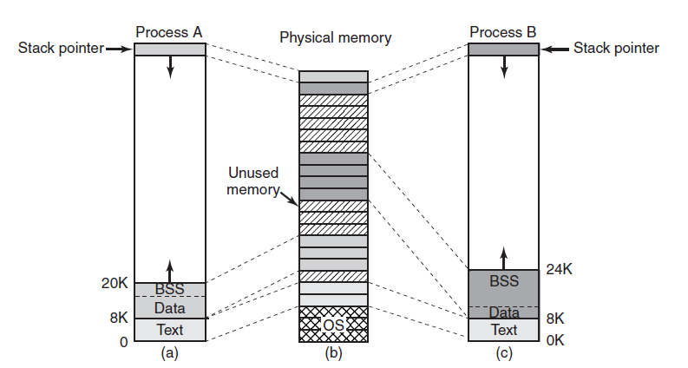
Memory Management Fundamental Concepts (1 of 2)
Figure 10-12. (a) Process A’s virtual address space. (b) Physical memory. (c) Process B’s virtual address space.

Slide 22
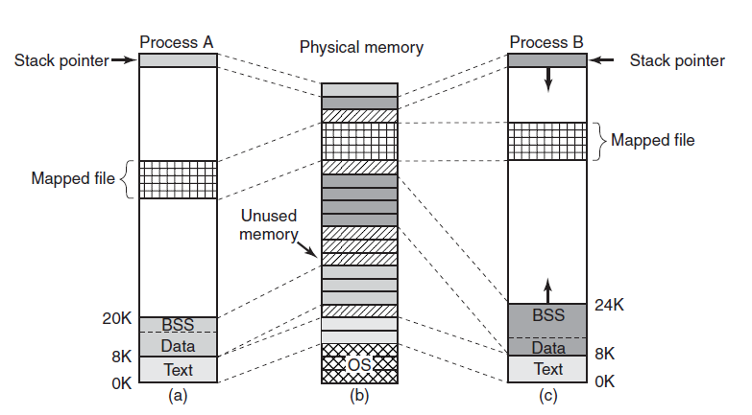
Memory Management Fundamental Concepts (2 of 2)
Figure 10-13. Two processes can share a mapped file.

Slide 23
Memory Management System Calls in Linux
Some system calls relating to memory management. The return code s is −1 if an error has occurred; a and addr are memory addresses, len is a length, prot controls protection, flags are miscellaneous bits, fd is a file descriptor, and offset is a file offset.
System call | Description
s = brk(addr) | Change data segment size
a = mmap(addr, len, prot, flags, fd, offset) | Map a file in
s = unmap(addr,len) | Unmap a file

Slide 24
Physical Memory Management (1 of 3)
Linux Memory Zones:
ZONE_D M A and ZONE_D M A32
ZONE_NORMAL
ZONE_HIGHMEM

Slide 25
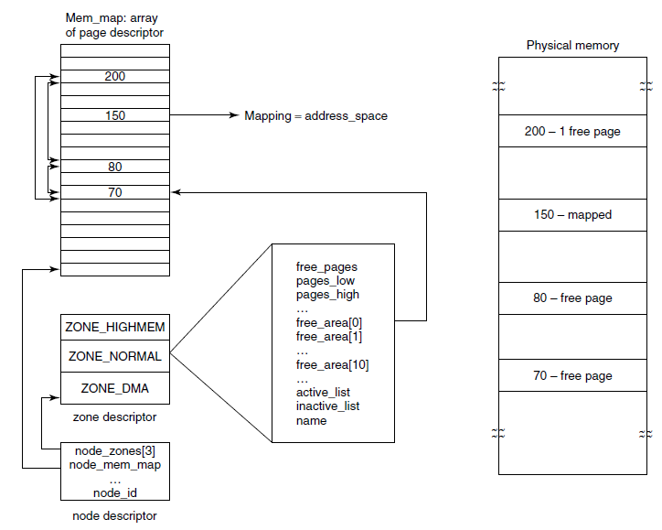
Physical Memory Management (2 of 3)
Figure 10-15. Linux main memory representation.

Slide 26
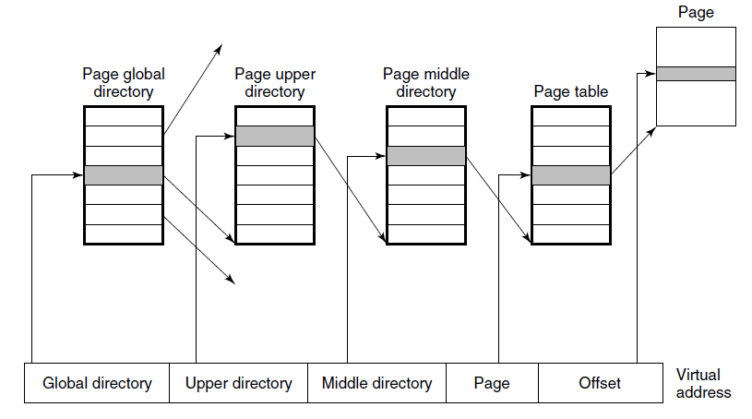
Physical Memory Management (3 of 3)
Figure 10-16. Linux uses four-level page tables.

Slide 27
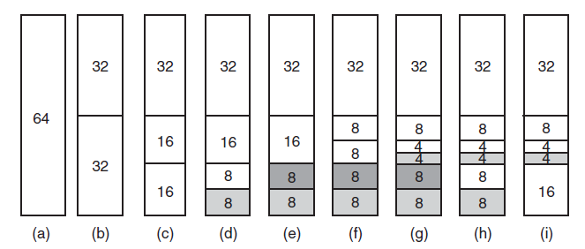
Memory Allocation Mechanisms
Figure 10-17. Operation of the buddy algorithm

Slide 28
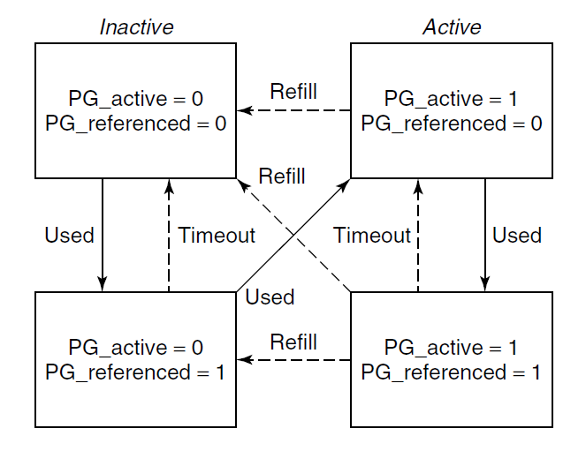
The Page Replacement Algorithm
Figure 10-18. Page states considered in the page frame replacement algorithm.

Slide 29
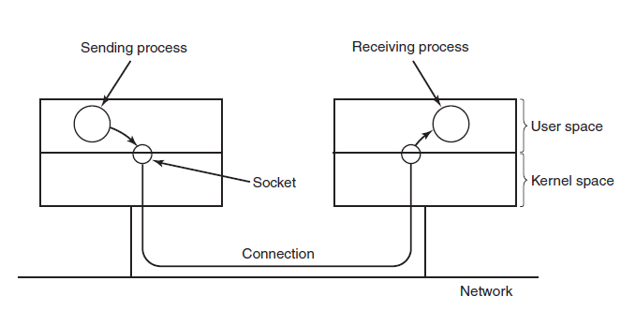
I/O in Linux – Networking (1 of 2)
Figure 10-19. The uses of sockets for networking

Slide 30
I/O in Linux – Networking (2 of 2)
Common socket types:
Reliable connection-oriented byte stream.
Reliable connection-oriented packet stream.
Unreliable packet transmission.

Slide 31
Input/Output System Calls in Linux
The main P O S I X calls for managing the terminal.
Function call | Description
s = cfsetospeed(&ter mios, speed) | Set the output speed
s = cfsetispeed(&ter mios, speed) | Set the input speed
s = cfgetospeed(&ter mios, speed) | Get the output speed
s = cfgtetispeed(&ter mios, speed) | Get the input speed
s = tcsetattr(fd, opt, &termios) | Set the attributes
s = tcgetattr(fd, &termios) | Get the attributes

Slide 32
Implementation of I/O in Linux (1 of 2)
Some of the file operations supported for typical character devices.
Device | Open | Close | Read | Write | Ioctl | Other
Null | null | null | null | null | null | …
Memory | null | null | mem_read | mem_write | null | …
Keyboard | k_open | k_close | k_read | error | k_loctl | …
Tty | tty_open | tty_close | tty_read | tty_write | tty_loctl | …
Printer | lp_open | lp_close | error | lp_write | lp_Ioctl | …

Slide 33
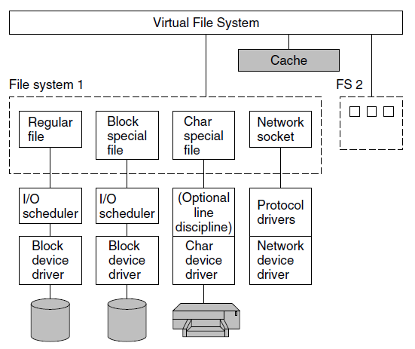
Implementation of I/O in Linux (2 of 2)
Figure 10-22. The Linux I/O system showing one file system in detail.

Slide 34
Linux File System: Fundamental Concepts (1 of 4)
Some important directories found in most Linux systems.
Directory | Contents
bin | Binary (executable) programs
dev | Special files for I/O devices
etc | Miscellaneous system files
lib | Libraries
usr | User directories

Slide 35
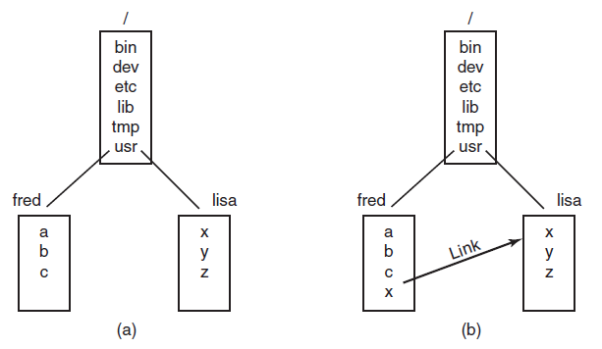
Linux File System: Fundamental Concepts (2 of 4)
Figure 10-24. (a) Before linking. (b) After linking.

Slide 36
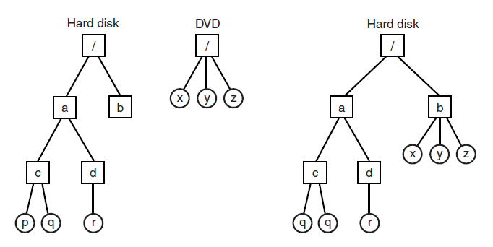
Linux File System: Fundamental Concepts (3 of 4)
Figure 10-25. (a) Separate file systems. (b) After mounting.

Slide 37
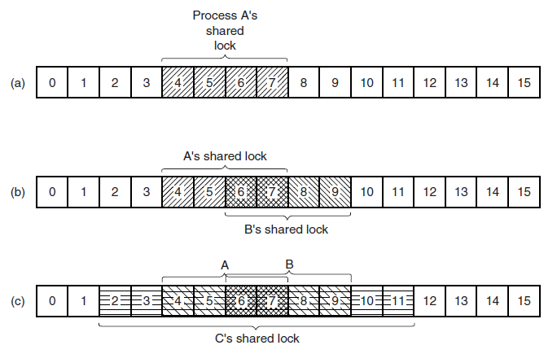
Linux File System: Fundamental Concepts (4 of 4)
Figure 10-26. (a) A file with one lock. (b) Addition of a second lock. (c) A third lock.

Slide 38
File System Calls in Linux (1 of 3)
Some system calls relating to files. The return code s is −1 if an error has occurred; fd is a file descriptor, and position is a file offset. The parameters should be self explanatory.
System call | Description
fd= creat(name, mode) | One way to create a new file
fd =open(file, how, ...) | Open a file for reading, writing, or both
s =close(fd) | Close an open file
n= read(fd, buffer, nbytes) | Read data from a file into a buffer
n= write(fd, buffer, nbytes) | Write data from a buffer into a file
position= Iseek(fd, offset, whence) | Move the file pointer
s =stat(name, &buf) | Get a file's status information
s =fstat(fd, &buf) | Get a file's status information
s=pipe(&fd[0]) | Create a pipe
s =fcntl(fd, cmd,…) | File locking and other operations

Slide 39
File System Calls in Linux (2 of 3)
The fields returned by the stat system call.
Device the file is on
I-node number (which file on the device)
File mode (includes protection information)
Number of links to the file
Identity of the file's owner
Group the file belongs to
File size (in bytes)
Creation time
Time of last access
Time of last modification

Slide 40
File System Calls in Linux (3 of 3)
Some system calls relating to directories. The return code s is −1 if an error has occurred; dir identifies a directory stream, and dirent is a directory entry. The parameters should be self explanatory.
System call | Description
s= mkdir(path, mode) | Create a new directory
s =rmdir(path) | Remove a directory
s= link(oldpath, newpath) | Create a link to an existing file
s =unlink(path) | Unlink a file
s =chdir(path) | Change the working directory
dir= opendir(path) | Open a directory for reading
s =closedir(dir) | Close a directory
dirent= readdir(dir) | Read one directory entry
rewinddir(dir) | Rewind a directory so it can be reread

Slide 41
The Linux Virtual File System
File system abstractions supported by the V F S.
Object | Description | Operation
Superblock | specific filesystem | read_inode, sync fs
Dentry | directory entry, single component of a path | create, link
I-node | specific file | d_compare, d_delete
File | open file associated with a process | read, write

Slide 42
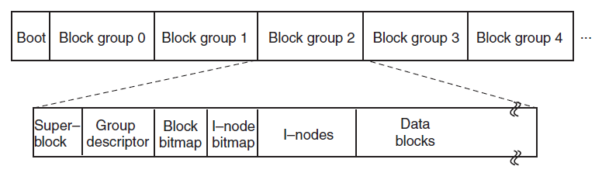
The Linux Ext2 File System ( 1 of 4)
Figure 10-31. Disk layout of the Linux ext2 file system.

Slide 43
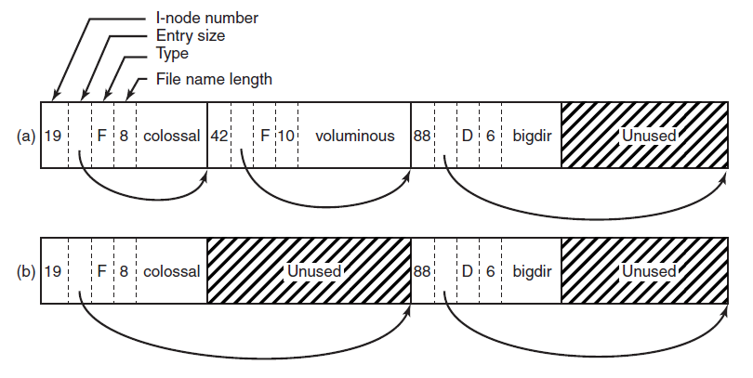
The Linux Ext2 File System (2 of 4)
Figure 10-32. (a) A Linux directory with three files. (b) The same directory after the file voluminous has been removed.

Slide 44
The Linux Ext2 File System (3 of 4)
Some fields in the i-node structure in Linux
Field | Bytes | Description
Mode | 2 | File type, protection bits, setuid, setgid bits
NIinks | 2 | Number of directory entries pointing to this i-node
Uid | 2 | UID of the file owner
Gid | 2 | GID of the file owner
Size | 4 | File size in bytes
Addr | 60 | Address of first 12 disk blocks, then 3 indirect blocks
Gen | 1 | Generation number (incremented every time i-node is reused)
Atime | 4 | Time the file was last accessed
Mtime | 4 | Time the file was last modified
Ctime | 4 | Time the i-node was last changed (except the other times)

Slide 45
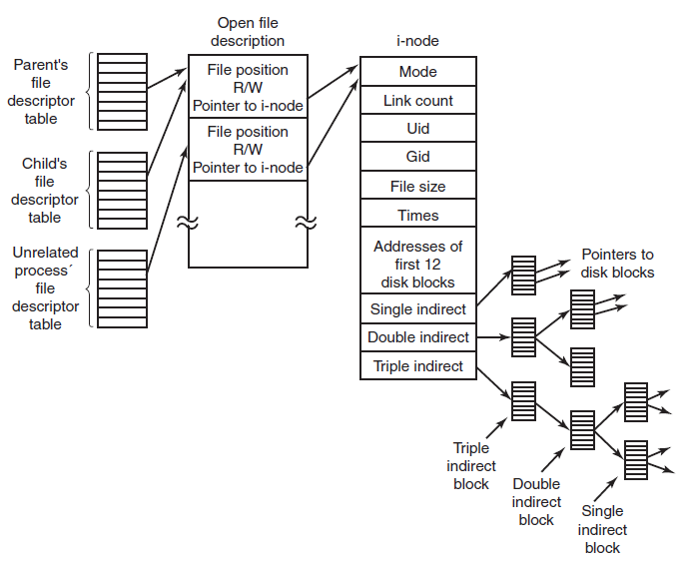
The Linux Ext2 File System (4 of 4)
Figure 10-34. The relation between the file descriptor table, the open file description table, and the i-node table.

Slide 46
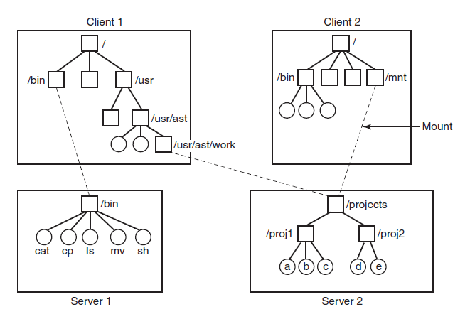
N F S Architecture
Figure 10-35. Examples of remote mounted file systems. Directories are shown as squares and files are shown as circles.

Slide 47
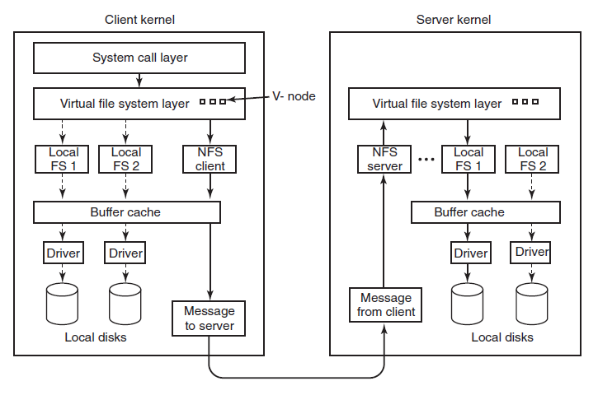
N F S Implementation
Figure 10-36. The N F S layer structure

Slide 48
Linux Security Fundamental Concepts
Some example file protection modes.
Binary | Symbolic | Allowed file accesses
1 11000000 | rwx——— | Owner can read, write, and execute
111111000 | rwxrwx--- | Owner and group can read, write, and execute
110100000 | Rw-r———— | Owner can read and write, and group can read
110100100 | Rw-r—r——— | Owner can read, write, and all others can read
111101101 | rwxr—xr x | Owner can do everything, rest can read and execute
000000000 | ——————— | Nobody has any access
000000111 | ————rwx | Only outsiders have access (strange, but legal)

Slide 49
Security System Calls in Linux
Some system calls relating to security. The return code s is −1 if an error has occurred; uid and gid are the U I D and G I D, respectively. The parameters should be self explanatory.
System Call | Description
s=chmod(path, mode) | Change a file's protection mode
s=access(path, mode) | Check access using the real I-JID and G I D
id getuid( ) | Get the real U I D
u i d geteuid( ) | Get the effective U I D
gid getg i d ( ) | Get the real G I D
gid geteg i d ( ) | Get the effective G I D
s chown(path, owner, group) | Change owner and group
s setuid(u i d) | Set the U D
s setgid(g i d) | Set the G I D

Slide 50
Android – Design Goals
Open-source platform for mobile devices
Support 3rd party apps with robust, stable A P I
3rd party apps compete on level playing field
Users need not deeply trust 3rd party apps
Support mobile user interaction
Manage app processes for users
Encourage apps to interoperate, collaborate
Full general-purpose O S

Slide 51
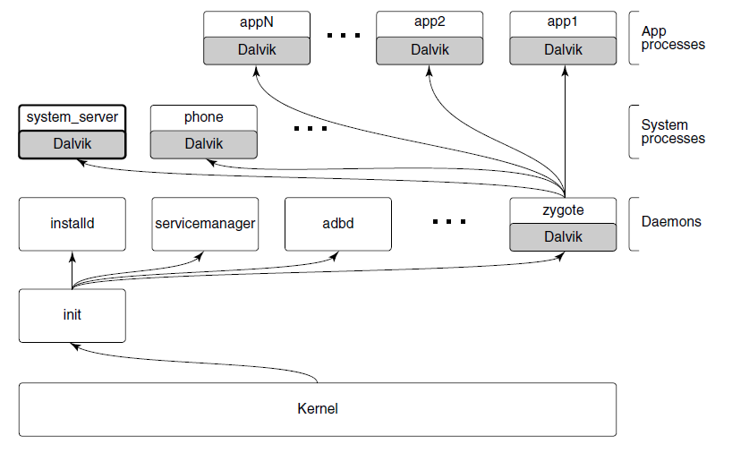
Android Architecture (1 of 2)
Figure 10-39. Android process hierarchy.

Slide 52
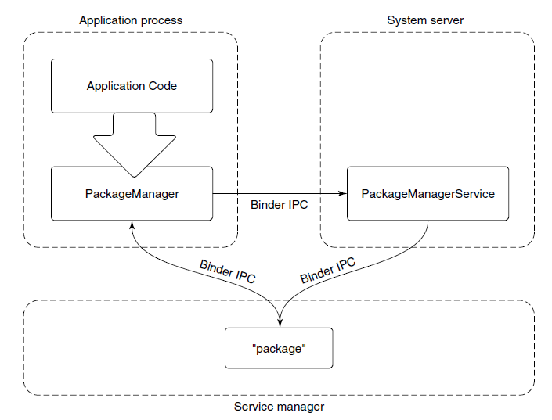
Android Architecture (2 of 2)
Figure 10-40. Publishing and interacting with system services.

Slide 53
Wake Locks
Contrast idle C P U , true sleep
Idle state may use more power than true sleep
Idle C P U can wake up at any moment if work becomes available
Idle C U P does not tell you that you can turn off other hardware not needed in true sleep

Slide 54
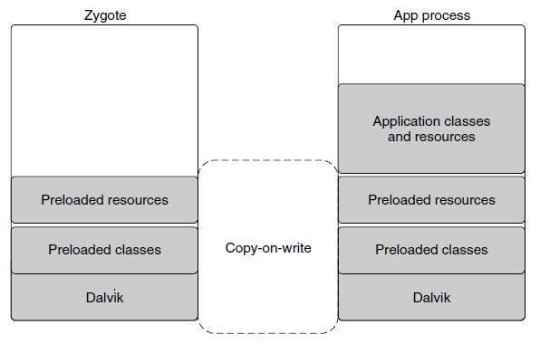
Dalvik
Figure 10-41. Creating a new Dalvik process from zygote.

Slide 55
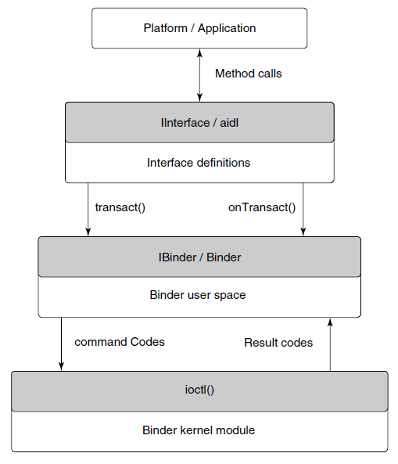
Binder I P C
Figure 10-42. Binder I P C architecture.

Slide 56
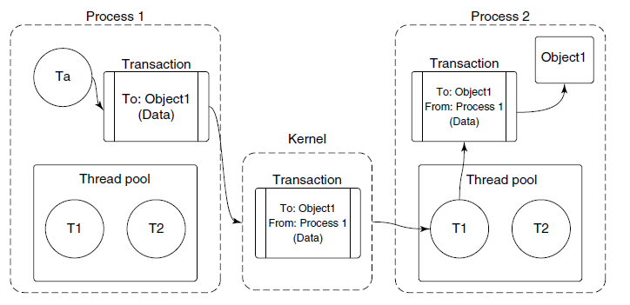
Binder Kernel Module (1 of 3)
Figure 10-43. Basic Binder I P C transaction

Slide 57
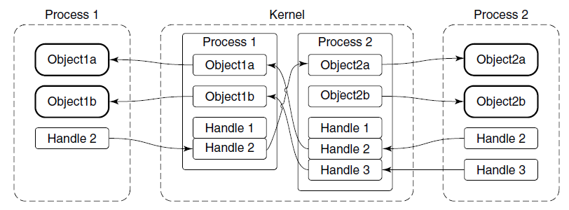
Binder Kernel Module (2 of 3)
Figure 10-44. Binder cross-process object mapping.

Slide 58
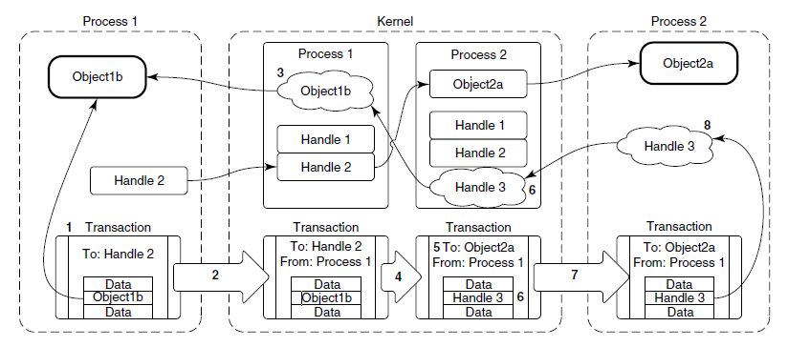
Binder Kernel Module (3 of 3)
Figure 10-45. Transferring Binder objects between processes.

Slide 59
Binder User-Space A P I (1 of 3)
User-space object-oriented library
IBinder is an abstract interface for a Binder object
Binder is a concrete Binder object
Parcel is a container for reading and writing data that is in a Binder transaction.

Slide 60
Binder User-Space A P I (2 of 3)
Three classes now make it fairly easy to write I P C code:
Subclass from Binder.
Implement onTransact to decode and execute incoming calls.
Implement corresponding code to create a Parcel that can be passed to that object’s transact method.

Slide 61
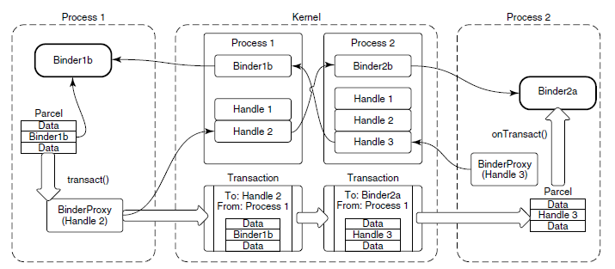
Binder User-Space A P I (3 of 3)
Figure 10-46. Binder user-space A P I.

Slide 62
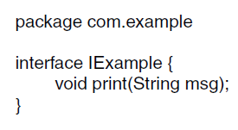
Binder Interfaces and A I D L (1 of 3)
Figure 10-47. Simple interface described in A I D L.

Slide 63
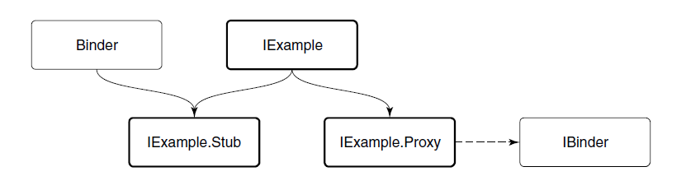
Binder Interfaces and A I D L (2 of 3)
Figure 10-48. Binder interface inheritance hierarchy.

Slide 64
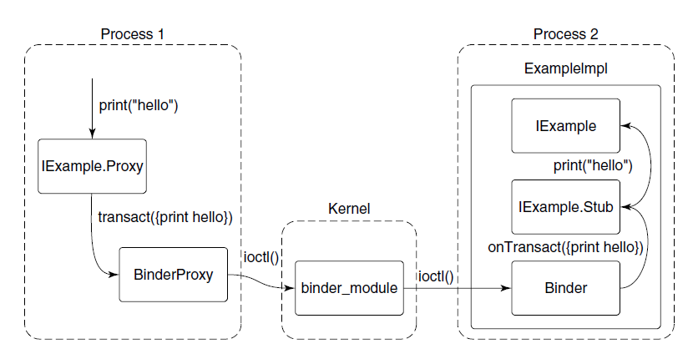
Binder Interfaces and A I D L (3 of 3)
Figure 10-49. Full path of an A I D L-based Binder I P C.

Slide 65
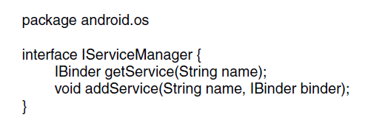
Android Applications (1 of 4)
Figure 10-50. Basic service manager A I D L interface.

Slide 66
Android Applications (2 of 4)
Contents of an apk
A manifest describing what the application is, what it does, and how to run it
Resources needed by the application
The code itself
Signing information, securely identifying the author

Slide 67
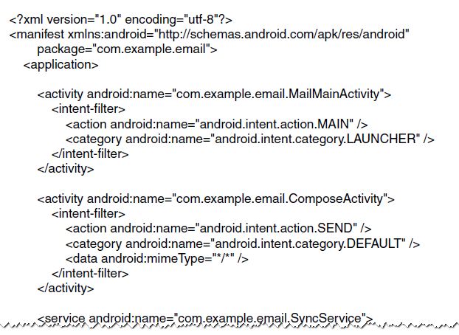
Android Applications (3 of 4)
Figure 10-51. Basic structure of AndroidManifest.xml.

Slide 68
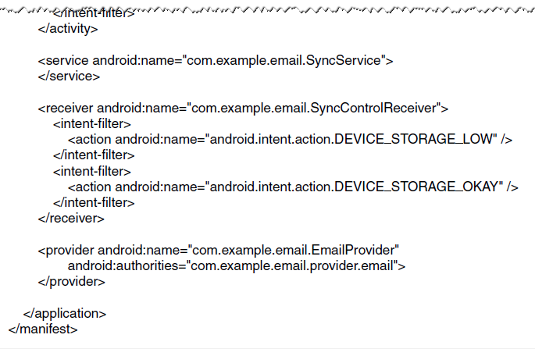
Android Applications (4 of 4)
Figure 10-51. Basic structure of AndroidManifest.xml.

Slide 69
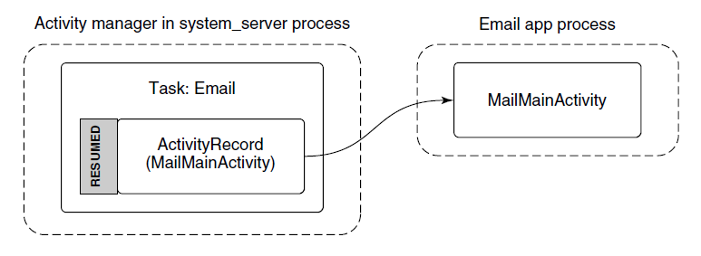
Activities (1 of 5)
Figure 10-52. Starting an email application’s main activity.

Slide 70
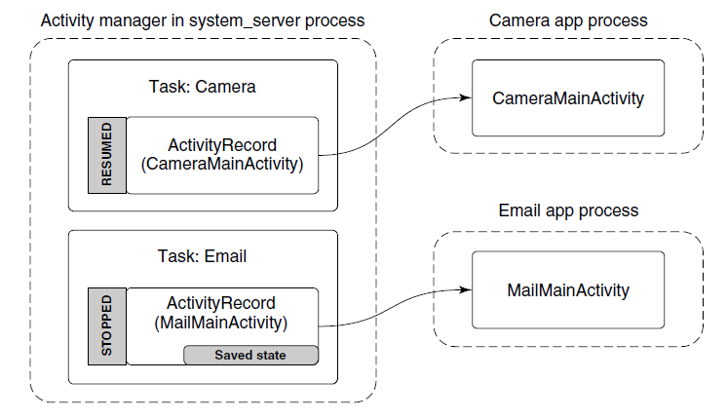
Activities (2 of 5)
Figure 10-53. Starting the camera application after email.

Slide 71
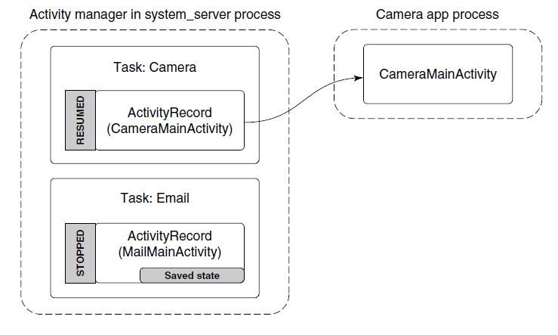
Activities (3 of 5)
Figure 10-54. Removing the email process to reclaim RAM for the camera.

Slide 72
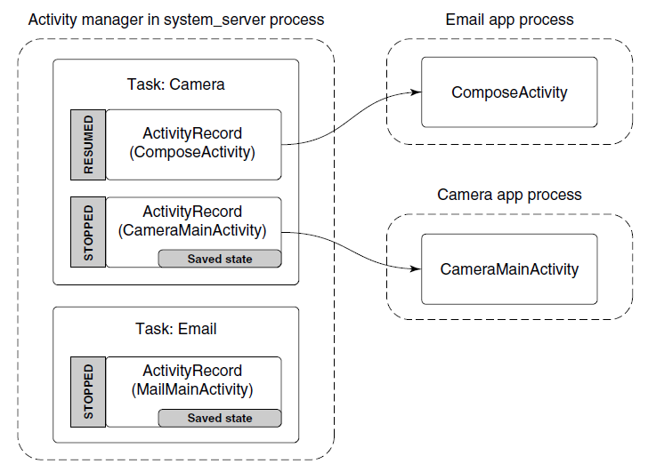
Activities (4 of 5)
Figure 10-55. Sharing a camera picture through the email application.

Slide 73
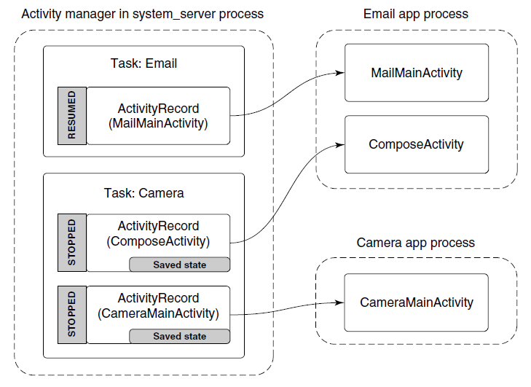
Activities (5 of 5)
Figure 10-56. Returning to the email application.

Slide 74
Services (1 of 4)
A service has two distinct identities:
It can be a self-contained long-running background operation.
It can serve as a connection point for other applications or the system to perform rich interaction with the application

Slide 75
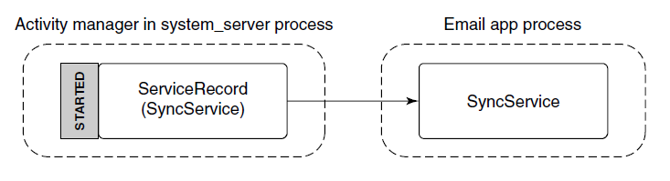
Services (2 of 4)
Figure 10-57. Starting an application service.

Slide 76
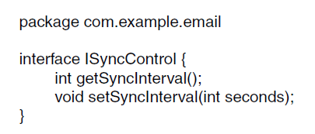
Services (3 of 4)
Figure 10-58. Interface for controlling a sync service’s sync interval.

Slide 77
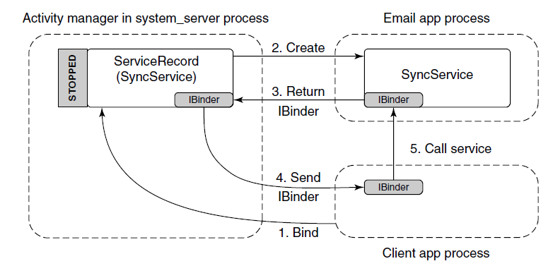
Services (4 of 4)
Figure 10-59. Binding to an application service.

Slide 78
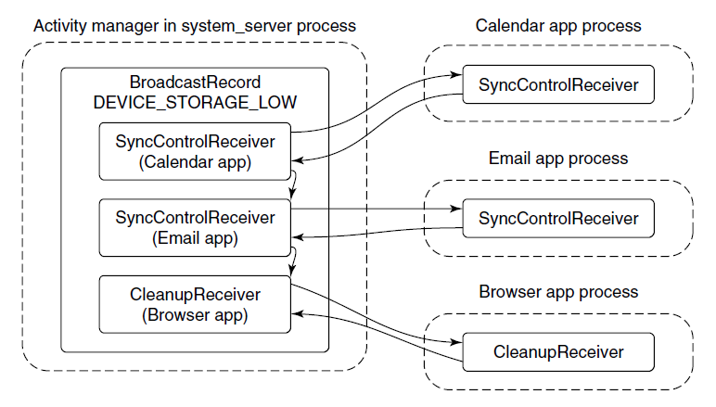
Receivers
Figure 10-60 Sending a broadcast to application receivers.

Slide 79
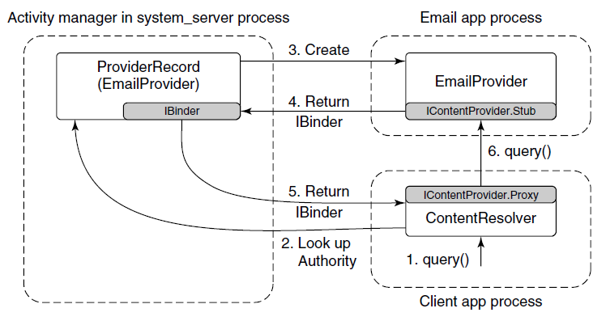
Content Providers
Figure 10-61 Interacting with a content provider.

Slide 80
Application Sandboxes: Security
Common U I D assignments in Android
U I D | Purpose
0 | Root
1000 | Coresystem(system_server process)
1001 | Telephony services
1013 | Low-level media processes
2000 | Command line shell access
10000-19999 | Dynamically assigned application U I Ds
100000 | Start of secondary users
Notes:
Figure 10-62 Common UID assignments in Android

Slide 81
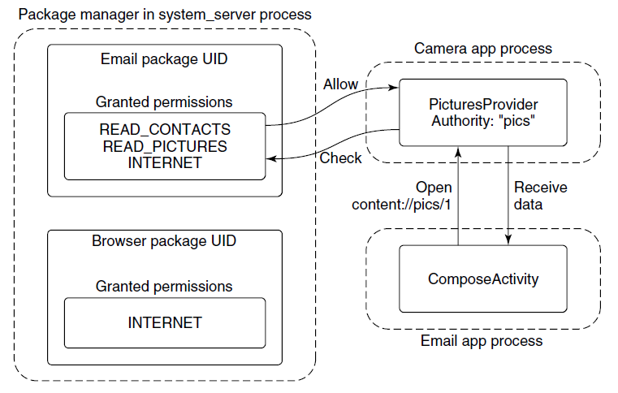
Security (1 of 4)
Figure 10-63. Requesting and using a permission.

Slide 82

Security (2 of 4)
Figure 10-64 Accessing data without a permission.

Slide 83

Security (3 of 4)
Figure 10-65 Sharing a picture using a content provider.

Slide 84

Security (4 of 4)
Figure 10-66 Adding a picture attachment using a content provider.

Slide 85

Starting Processes
Figure 10-67 Steps in launching a new application process.

Slide 86
Process Lifecycle
Process importance categories.
Category | Description | oom_adj
SYSTEM | The system and daemon processes | -16
PERSISTENT | Always-running application processes | -12
FOREGROUND | Currently interacting with user | 0
VISIBLE | Visible to user | 1
PERCEPTIBLE | Something the user is aware of | 2
SERVICE | Running background services | 3
HOME | The home/launcher process | 4
CACHED | Processes not in use | 5
Notes:
Figure 10-68 Process importance categories.

Slide 87
Process Dependencies (1 of 2)
Typical state of process importance
Process | State | Importance
system | Core part of operating system | SYSTEM
phone | Always running for telephony stack | PERSISTENT
email | Current foreground application | FOREGROUND
camera | In use by email to load attachment | FOREGROUND
music | Running background service playing music | PERCEPTIBLE
media | In use by music app for accessing user’s music | PERCEPTIBLE
download | Downloading a file for the user | SERVICE
launcher | App launcher not current in use | HOME
maps | Previously used mapping application | CACHED
Notes:
Figure 10-69. Typical state of process importance

Slide 88
Process Dependencies (2 of 2)
Process state after email stops using camera
Process | State | Importance
system | Core part of operating system | SYSTEM
phone | Always running for telephony stack | PERSISTENT
email | Current foreground application | FOREGROUND
camera | In use by email to load attachment | PERCEPTIBLE
music | Running background service playing music | PERCEPTIBLE
media | In use by music app for accessing user’s music | SERVICE
download | Downloading a file for the user | HOME
launcher | App launcher not current in use | CACHED
maps | Previously used mapping application | CACHED+1
Notes:
Figure 10-70. Process state after email stops using camera

Slide 89

Copyright

